Slide 1


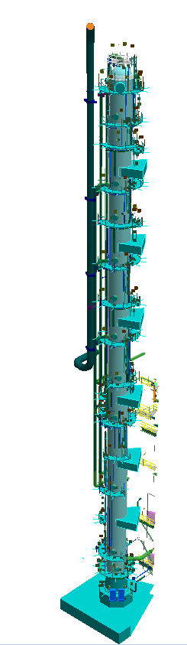
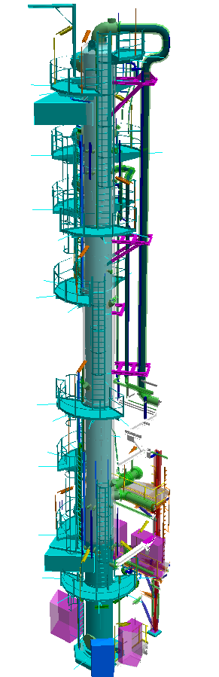
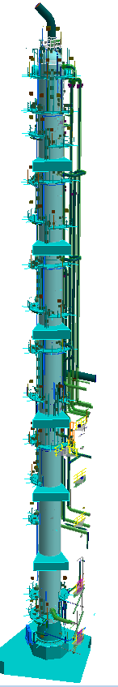
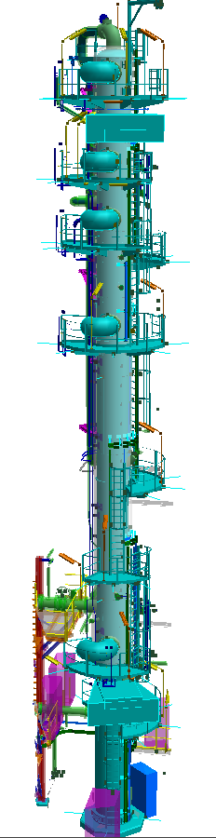
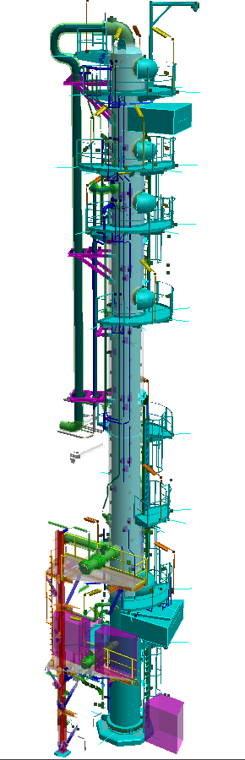
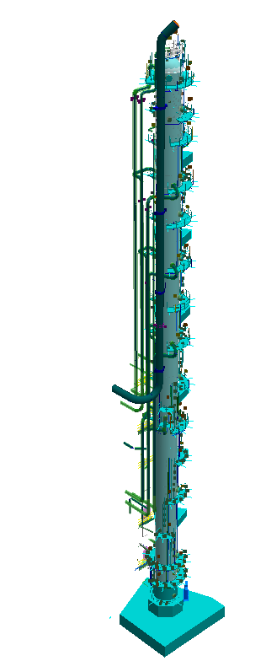
PROJECT OVERVIEW OF
LINDE
PRE-DRESSING OF COLUMNS

Slide 2

AGENDA
PROJECT INTRODUCTION
1
SCOPE OF WORK
2
PROJECT MILESTONES
3
PROJECT MANAGEMENT TEAM
4
EARLY WORKS
5

Slide 3








1
PROJECT INTRODUCTION
PROJECT NAME:
LINDE – PRE-DRESSING
OF COLUMNS
CLIENT:
LINDE GROUP
CONSTRUCTION:
PIPING/ E&I
DURATION:
02/01/2020 – 15/09/2020
TOTAL PIPING WEIGHT:
199.9 TONS
TOTAL DIA-INCH:
10046.5 DIA
TOTAL INSULATION AREA:
5448 M2
TOTAL PAINTING AREA
1463.2 M2

Slide 4
1
PROJECT INTRODUCTION
DESCRIPTION
METHANOL WASH COLUMN
TAG NAME
1302T01
HEIGHT
96M
INSULATION
COLUMN: 1200M2 – PIPING: 771.2M2
PIPING
13 PCS – 2692 DIA – 703M – 61.5T
PAINTING
635M2
85% MATERIAL
20/02/2020

Slide 5
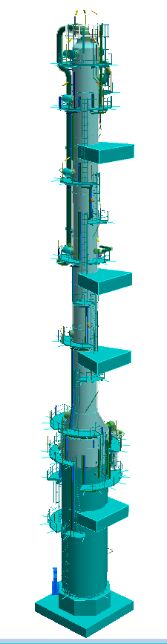
1
PROJECT INTRODUCTION
DESCRIPTION
HOT REGENERATION COLUMN
TAG NAME
1307T04
HEIGHT
67M
INSULATION
COLUMN: 660M2 – PIPING: 158.5M2
PIPING
12 PCS – 1182 DIA – 373M – 10.8T
PAINTING
122.2M2
85% MATERIAL
20/02/2020

Slide 6
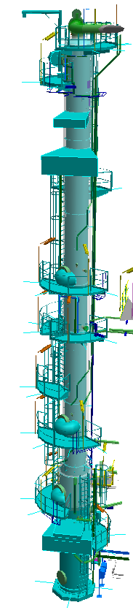
1
PROJECT INTRODUCTION
DESCRIPTION
METHANOL/ WATER SEPERATION COLUMN
TAG NAME
1309T05
HEIGHT
39M
INSULATION
COLUMN: 160M2 – PIPING: 29.1M2
PIPING
7 PCS – 351 DIA – 175M – 1.65T
PAINTING
23.1M2
85% MATERIAL
20/02/2020

Slide 7
1
PROJECT INTRODUCTION
DESCRIPTION
SOUR WATER STRIPPER
TAG NAME
1206T01
HEIGHT
34M
INSULATION
COLUMN: 150M2 – PIPING: 44M2
PIPING
11 PCS – 457 DIA – 191M – 4.2T
PAINTING
55.2M2
85% MATERIAL
20/02/2020

Slide 8
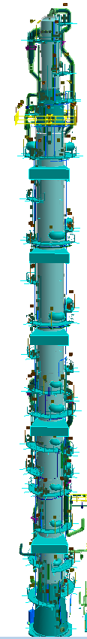
1
PROJECT INTRODUCTION
DESCRIPTION
H2S ENRICHMENT COLUMN INCLUDING CO2 SEPARATOR
TAG NAME
1306T03/1304D13
HEIGHT
83M
INSULATION
COLUMN: 1150M2 – PIPING: 833.8M2
PIPING
16 PCS – 2981 DIA – 840M – 69.7T
PAINTING
507.1M2
85% MATERIAL
20/02/2020

Slide 9
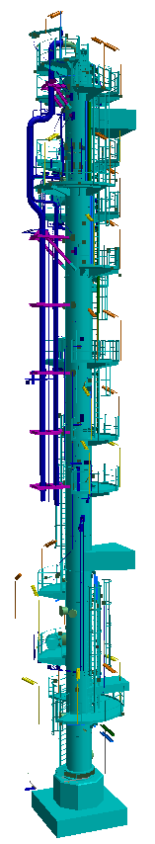
1
PROJECT INTRODUCTION
DESCRIPTION
SOUR WATER STRIPPER II
TAG NAME
1206T11
HEIGHT
35M
INSULATION
COLUMN: 190M2 – PIPING: 71.7M2
PIPING
11 PCS – 811 DIA – 269M – 6.2T
PAINTING
81.2M2
85% MATERIAL
20/02/2020

Slide 10
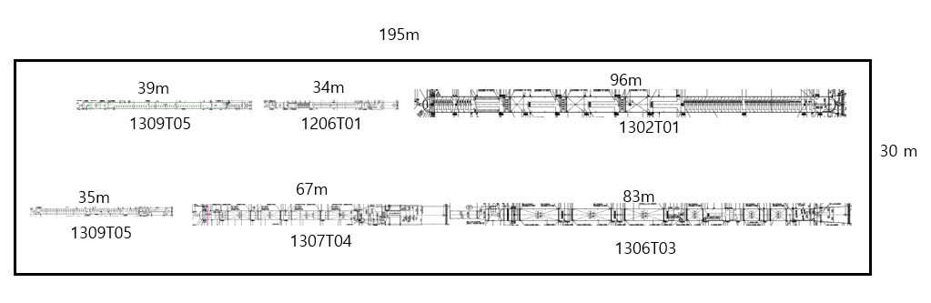
1
PROJECT INTRODUCTION
MINIMUM REQUIRED AREA FOR PRE-DRESSING OF COLUMNS

Slide 11
2
SCOPE OF WORK
1
Receive free-issued materials (Piping, E&I) CIF at commercial port
2
Receive Column bodies at PTSC M&C yard follow CIF
3
Pre-fabricate piping, painting (including PWHT, NDT, RT service)
4
Installation of piping, valves, Insulation (Include supply insulation materials) for all columns
5
Supply materials, fabrication, installation EIT support materials.
Install cable tray ladder, cable pulling, tubing connection.
Install electrical heat tracing, lighting, junction boxes
6
Preservation, Mechanical Completion and Load-out (FOB) (without sea fastening)

Slide 12
3
PROJECT EXECUTION MILESTONES
Open file
Start mobilization of Project team
Start insulation work and EIT
First cutting
(LD)
15/01/20
03/06/20
15/09/20
02/01/20
15/02/20
29/06/20
Start receiving materials free issue by Company
Start installation work
Mechanical Completion

Slide 13
4
PROJECT MANAGEMENT TEAM (SUBMITTED)
PROJECT DIRECTOR
NGUYỄN DƯƠNG LÂM
PROJECT MANAGER
NGUYỄN HỮU TUẤN
PROJECT COORDINATOR
PROJECT CONTROL
MANAGER
DOCUMENT CONTROLLER
PHAM NAM THAI
NGUYỄN ĐỨC ANH
ĐOÀN QUỐC DŨNG – CONTRACT ENGINEER
TẠ VĂN SƠN
LEAD CONST.
ENGINEERING
PROCUREMENT
MANAGER
LEAD HSE OFFICER
PLANNING
MANAGER
QC MANAGER
CONSTRUCTION
MANAGER
TRẦN BÌNH NAM
TRẦN T. T. HUYỀN
TRẦN HẢI QUÂN
VÕ MINH TRƯỜNG
BÙI CAO KHẢI
NGUYỄN THANH NGỌC
MATERIAL
CONTROLLER
STR/PIP/MEC
INSPECTOR
PAINTING/
SCAFFOLD SUP.
LIFTING CE
TBA
ĐẶNG VĂN TOÀN
TBA
CHU XUÂN AN
EIT CE
E&I
INSPECTOR
STR/PIP/MEC SUP.
TBA
NGUYỄN KHẮC TRỌNG
TBA
PIPING CE
E&I SUP.
TBA
ĐINH QUỐC ÂN
PRODUCTION
CONTROL LEADER
TRẦN KHÁNG

Slide 14
5
EARLY WORKS
Open link
1
Final PMT submission
2
Preparation for Office, Warehouse and Fabrication workshop
3
Develop Project Schedule
4
Project Procedures preparation
5
Budget preparation
6
WPS & Welder Qualification, Test panel
7
Order consumables
8
Issue shop drawing
9
Mobilization equipment and tools
10
Mobilization direct manpower

